Slide 1
DSP HW5 Changing Sampling Rate
Assigned 2020/12/24

Slide 2
Objective
To understand up-sampling and down-sampling techniques
To implement an FIR low-pass filter
To observe spectrogram of signal

Slide 3

Specification
T = 1/44100 sec for input signal
TM/L = 1/8000 sec for output signal
Input signal x[n]: input.wav, a stereo music file (44.1kHz, 16bits)
Output signal ${\tilde{x}}_{d}[n]$: output.wav, a stereo music file (8kHz, 16bits)

Slide 4

FIR Low-Pass Filter
The filter can be designed by (see Ch. 7.5 for more details)
$ω_{c}$ is the cutoff frequency
$$\frac{sin\left[ω_{c}\left(n−P/2\right)\right]}{π\left(n−P/2\right)} is the impulse response of the ideal low pass filter$$
$w\left[n\right]$ is the window function and $w\left[n\right]≠0 for n=0\sim P$
$w\left[n\right]$ can be Hamming window, Hanning window or Kaiser window

Slide 5
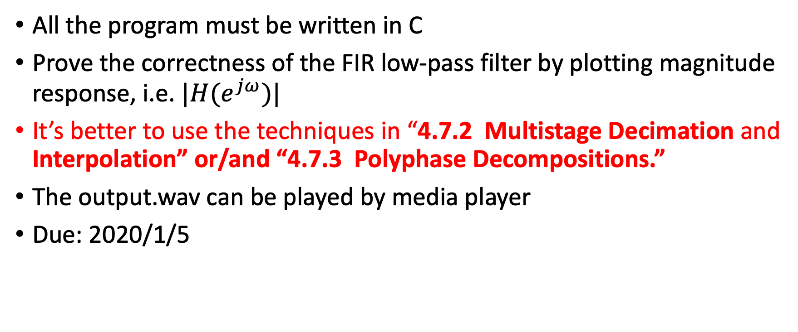
Requirement
All the program must be written in C
Prove the correctness of the FIR low-pass filter by plotting magnitude response, i.e. $|H(e^{jω})|$
It’s better to use the techniques in “4.7.2 Multistage Decimation and Interpolation” or/and “4.7.3 Polyphase Decompositions.”
The output.wav can be played by media player
Due: 2020/1/5

